Slide 1


Employee Attrition Problem of Company X
Data analytics solution
by - David Akinmade

Slide 2
Methodology
Introduction
Data Exploration
Feature selection
Modelling
Results

Slide 3
Introduction
This project starts with the dataset of existing employees provided by company X. Over the rest of this presentation I would be explaining my step-by-step approach to solving this attrition problem, and giving a presentation of my results as far as the objectives provided are concerned, with image snippets to corroborate my explanations.
Objectives of project are:
To determine which type of employees are leaving
To predict which employees are prone to leave next.

Slide 4
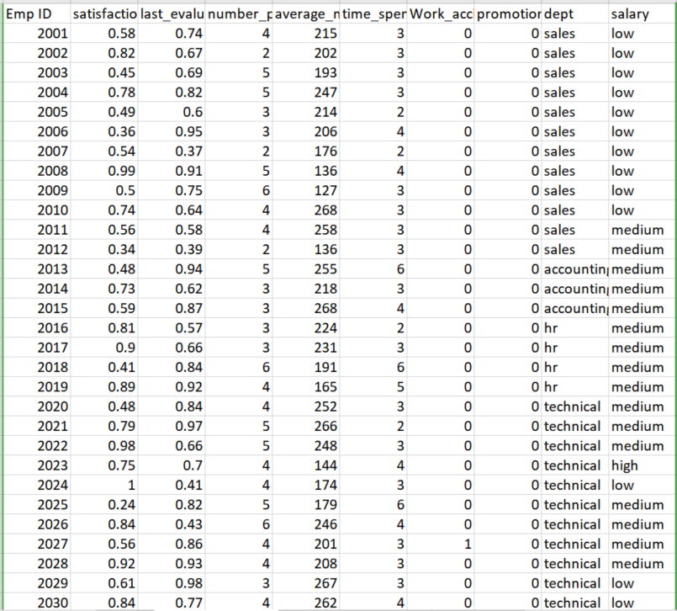
Introduction: Sample Input
Provided here is a sample of the dataset to be classified. The information about the employee provided include: salary, satisfaction level, department, promotion, time spent at company, Last evaluation,
Number of projects, Average monthly hours, and Whether they have had a work accident

Slide 5
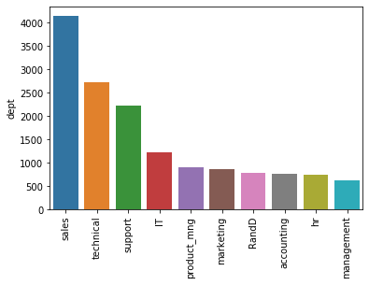
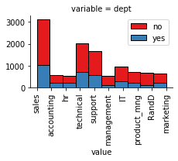
Stage 1: Data Exploration
To begin with, a broad understanding of the dataset was obtained through the univariate and bivariate analysis of the datasets to get a broad understanding of the relatioship between features, before selection.

Slide 6
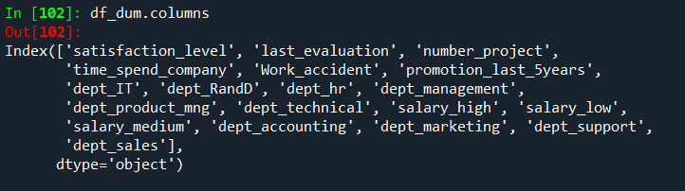
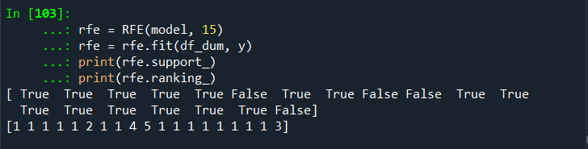
Stage 2: Feature selection
Next I created the dummy variables for the predictor columns and then ranked the top 15 relevant columns using 'Recursive Feature Elimination' in order to select the top performing features for modelling

Slide 7

Stage 3: Model Development
The algorithms that were tested are XGBoost, SVM and Random Forest. This is because of their efficiency in handling imbalanced data, and they were compared against a Dummy Classifier baseline model. The modelling proceded as follows:
Splitting data into training and test sets, and also making sure to stratify the data so that the proportion of positive to negative data(ex to current employees) is maintained.
Importing and implementing each algorithm one after the other to check their performance specifically their precision and recall since only overall accuracy would be very misleading owing to the nature of the data.

Slide 8
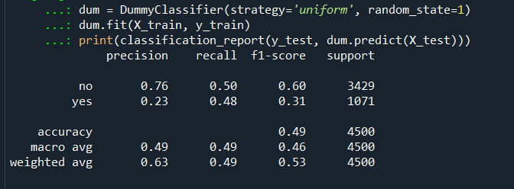
Stage 3: Creating baseline model with Dummy Classifier
The baseline model was created using Dummy Classifier which makes predictions based on the mean occurence of each label. It had a precision and recall average of 0.49 respectively. This served as a benchmark performance which the other models had to out-perform

Slide 9
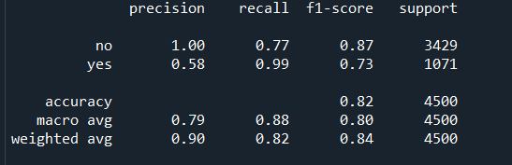
Stage 3: Modelling with XGBoost
The first model tested was the Xgboost. It performed decently with a precision of 0.79 and a recall of 0.88. It was however poor in it's precision for positive cases of attrition with a percentage of 0.58.

Slide 10
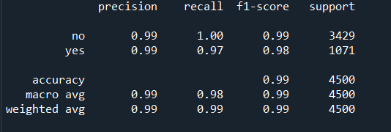
Stage 3: Modelling with Random Forest
RandomForest was a much better algorithm than XGBoost. It performed impressively with a precision of 0.99 and a recall of 0.98. Only its ability to recall positive attrition values lagged behind slightly at 0.97.

Slide 11
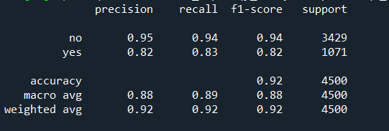
Stage 3: Modelling with SVC
While not being as high performing as Random Forest, SVC proved to be better than XGBoost. It performed well with a precision of 0.88 and a recall of 0.89. Its precision and recallof positive attrition values was at 0.82 and 0.83 respectively.

Slide 12
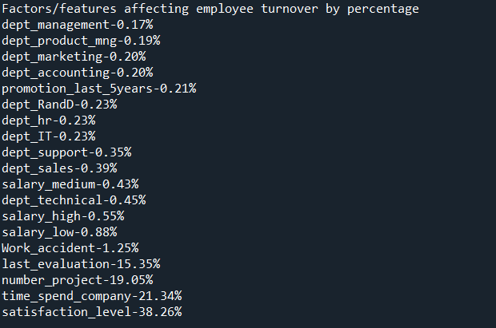
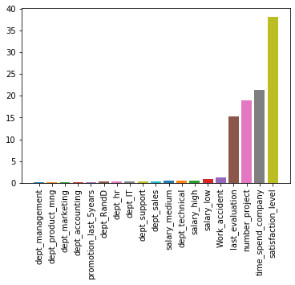
Stage 4: Results (Feature Importance)
From the modelling phase, Random Forest proved itself to be the most accurate model as far as the important metrics were concerned and it was thereby selected. Upon fitting and prediction, to answer the first objective, the type of employees prone to leave were discovered to be those with: low salary, low satisfaction levels, less time spent with company and lower scores during last evaluation.

Slide 13
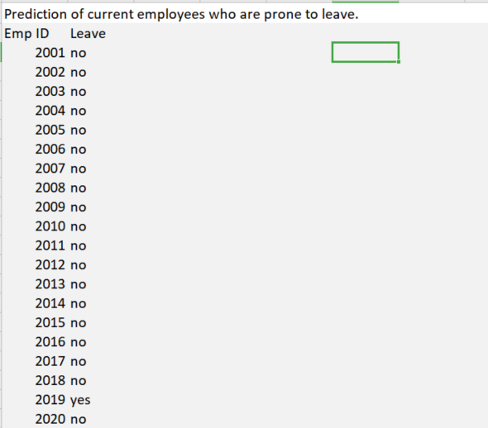
Stage 4: Results (Sample Output)
Finally with a suitably accurate model already obtained and the relevant reasons for attrition clearly identified, the list of existing employees was fed to the model and an output of employees predicted to leave was obtained. Out of 11428 employees, 55 were predicted to leave, thus concluding the scope of the project.

Slide 14
Appendix

